Slide 1

BlinkIT Business Analytics Dashboard
Sales & Outlet Performance Analysis using Power BI
Presented by:
Nishtha Varlani

Slide 2
About me
Background : M.Sc. Physics Khandesh Education Society, East Pratap College, Amalner
Why I want to learn Data Science : I want to learn Data Science because I enjoy analytical problem-solving and working with technology. My Physics background has developed my logical and mathematical thinking, and Data Science allows me to apply those skills to real-world problems.
Experience : Fresher
linkedin and github profile urls : linkedin.com/in/nishtha-varlani-01122004n & github.com/nishthavarlani-0104

Slide 3
Agenda (This should be the PPT flow)
Business Problem Statement
Project Objectives
Dataset Overview & Data Source
Business Requirements & Key Analysis Questions
Data Understanding & Data Preparation
Data Cleaning & Transformation using Power Query
Data Model & Relationships
DAX Measures & Calculated Columns
Dashboard Design & Visualizations
Key Business Insights & Findings
Key Conclusion & Recommendations
Challenges Faced During the Project
Future Improvements
Q&A
Tools & Technologies:
Power BI • Power Query • DAX • Data Visualization
Project: Business Intelligence & Data Analytics

Slide 4
Business Problem Statement
BlinkIT generates sales across multiple product categories, outlet types, outlet sizes, and location tiers. However, raw sales data alone does not provide an easy way to identify performance patterns.
“The main problem was that the raw dataset contained a large amount of information, but it was difficult to directly understand the business performance from it. Therefore, I developed a Power BI dashboard to analyze sales across products, outlets and locations and convert the raw data into actionable insights.”

Slide 5
Project Objectives
Analyze overall sales performance using key performance indicators.
Identify top-performing product categories and items.
Compare sales across different outlet types.
Analyze sales across location tiers.
Understand the distribution of sales by fat content.
Analyze item visibility versus sales.
Evaluate average item ratings as a customer satisfaction indicator.
Analyze sales according to outlet establishment year.
Build an interactive Power BI dashboard using slicers and drill-through.
Generate business insights and recommendations from the analysis.

Slide 6
BUSINESS REQUIREMENTS
Sales Performance
What is the total sales?
What is the average sales per outlet?
Which product categories generate the highest sales?
Product Analysis
Which are the Top 10 items by sales?
How does item visibility relate to sales?
How do sales differ by fat content?
Outlet Analysis
Which outlet type generates the highest sales?
Which location tier performs best?
Does outlet establishment year show any meaningful sales pattern?
Customer Perspective
What is the average item rating?

Slide 7
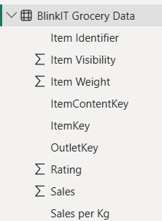
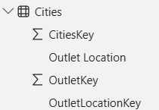
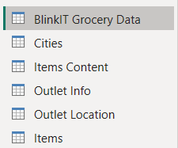
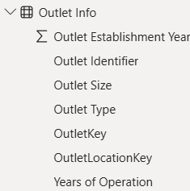



DATASET OVERVIEW & DATA SOURCE
Dataset: BlinkIT Grocery Sales Dataset
The project uses a grocery sales dataset containing 8,523 records with information about products, sales, outlets, locations and ratings.
Supporting Table
Items, Item Content / Fat Content, Outlet Information, Outlet Location, Cities (reference table)

Slide 8
DATA UNDERSTANDING
DATA PREPARATION
Total records in main sales table: 8,523
Product information was available through an Item lookup table.
Outlet information was available through an Outlet lookup table.
Location information was available through an Outlet Location table.
Product fat content was standardized through a separate Item Content table.
The dataset contains 16 item categories.
Outlet locations are classified into 3 tiers: Tier 1, Tier 2, Tier 3
Checking and correcting data types
Identifying missing values
Standardizing categorical values
Checking the uniqueness of dimension keys
Separating the data into appropriate tables
Preparing the data for a structured Power BI model
Important Data Quality Point
Item Weight contains missing values.
1,463 records have missing Item Weight values.
These records were not deleted or replaced with zero, because they still contain valid sales information

Slide 9
Data Cleaning & Transformation Using Power Query
Power Query was used to clean and transform the dataset before creating the Power BI data model. The data types of important columns were corrected and categorical values were standardized to maintain consistency. For example, the different fat-content labels such as Regular, reg, Low Fat, low fat and LF were standardized into two consistent categories: Regular and Low Fat. During this process, records with invalid or null fat-content values that could not be standardized were removed from the Item Content data.
The dimension tables were also cleaned by checking their keys and removing unnecessary duplicate or null key entries where required. The main sales records were retained so that valid sales information was not lost. A Sales per Kg calculated column was also created using Sales divided by Item Weight, while records without a valid Item Weight were kept blank for this calculation. Additionally, a Years of Operation column was created using the outlet establishment year.

Slide 10
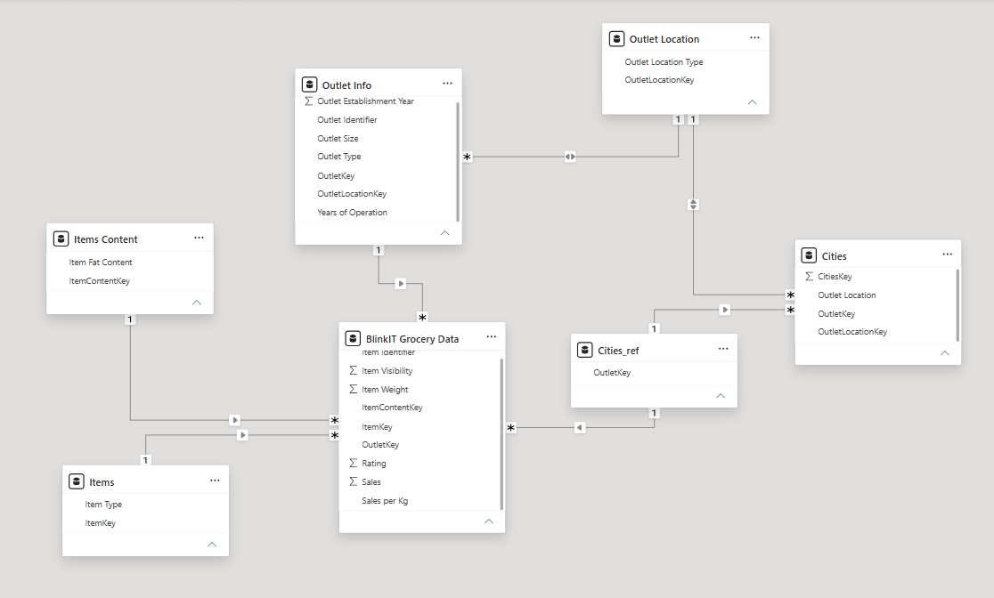
Model View
Data Model & Relationships
The project uses a structured star/snowflake-style data modeling approach to make the Power BI report efficient and easy to analyze. The BlinkIT Grocery Data table acts as the central fact table containing sales-related information, while the Item, Item Content, Outlet and Location tables provide descriptive details. The Item, Item Content and Outlet tables are directly connected to the sales table, while the Outlet Location table is connected through the Outlet table. This structure reduces unnecessary repetition of information and allows filters such as Item Type, Fat Content, Outlet Type and Location Tier to work correctly across the dashboard.
The model also uses one-to-many relationships with single-direction filtering, allowing information to flow from the dimension tables toward the sales data.

Slide 11
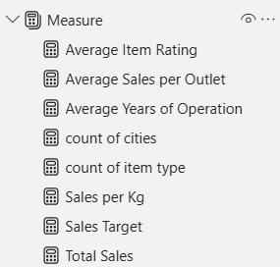
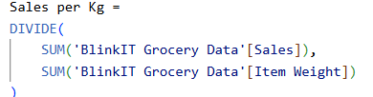
DAX Measures & Calculated Columns
DAX (Data Analysis Expressions) was used in Power BI to create dynamic measures for the dashboard. These measures automatically respond to the selected filters and provide the required business calculations

Slide 12
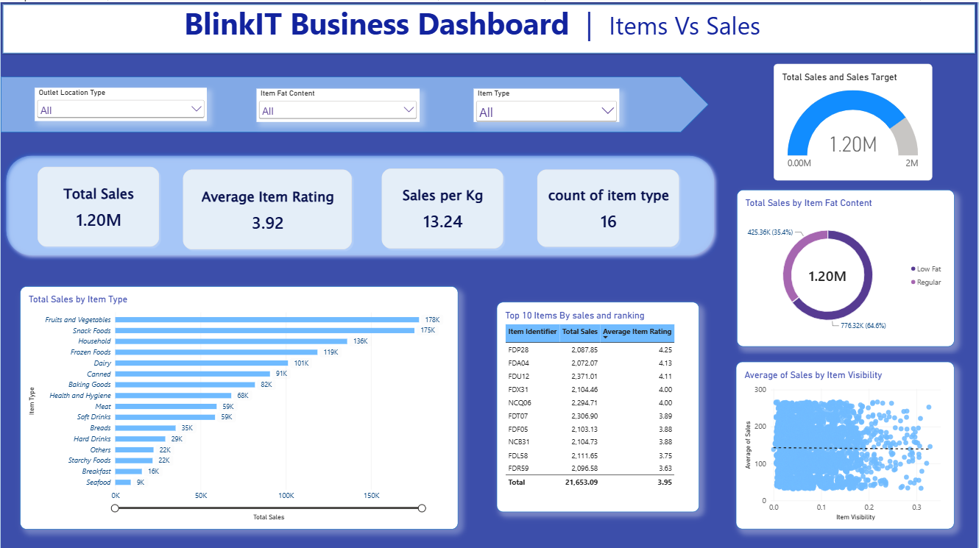
DASHBOARD DESIGN & VISUALIZATIONS

Slide 13
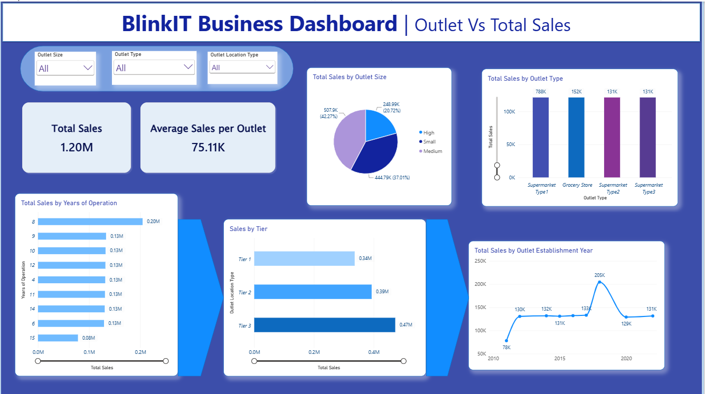

Slide 14
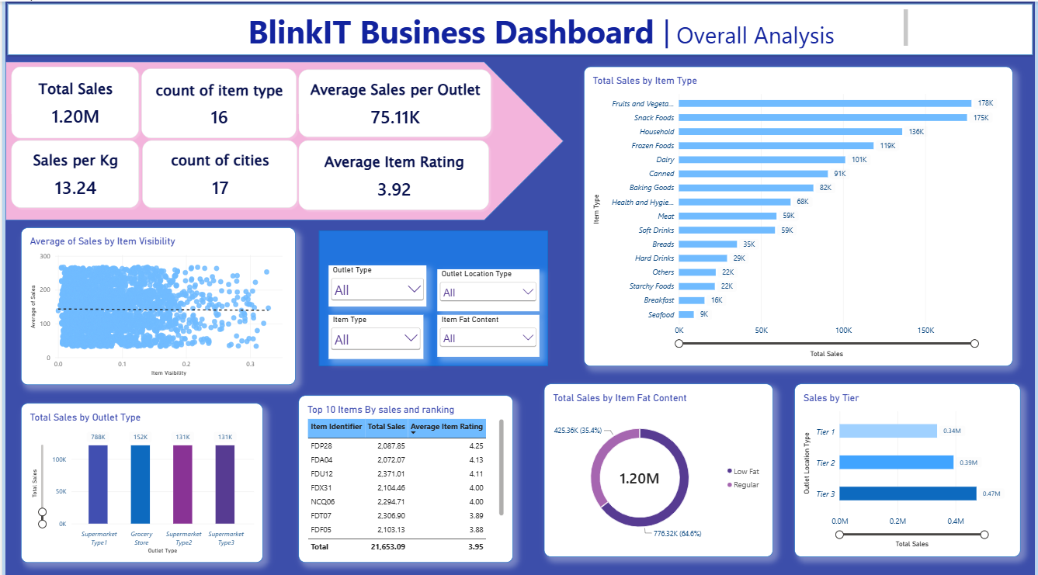
Key Takeaways
Highest Category: Fruits & Vegetables — ~178K
Highest Outlet Type: Supermarket Type1 — ~788K
Highest Location Tier: Tier 3 — ~0.47M
Leading Fat Content: Low Fat — 64.6% of sales
Average Rating: ~3.92
Average Sales per Outlet: ~75.11K
Sales per Kg: ~13.24

Slide 15
Recommendations
Total sales of approximately 1.20M
Fruits & Vegetables is the highest-selling category
Supermarket Type1 contributes the highest outlet-type sales
Tier 3 outlets generate the highest sales
Low Fat products contribute 64.6% of total sales
Average item rating is approximately 3.92
Dashboard provides interactive product and outlet-level analysis
Key Conclusion
Focus on high-performing product categories
Analyze factors behind strong Tier 3 performance
Maintain effective product assortment for Low Fat products
Review lower-performing outlets/categories for improvement

Slide 16
CHALLENGES FACED
FUTURE IMPROVEMENTS
Handling missing Item Weight values
Standardizing inconsistent Fat Content values
Cleaning dimension tables and maintaining valid keys
Creating correct table relationships
Developing dynamic DAX measures
Designing multiple interactive dashboard pages
Choosing suitable visuals when some business metrics were unavailable
Add transaction/order dates for true sales trend analysis
Add Cost, COGS and Profit data for profit-margin analysis
Add customer/order data for conversion analysis
Include more detailed customer segmentation
Add forecasting for future sales
Connect the dashboard to real-time/updated data
Develop deeper outlet and product performance analysis

Slide 17


Slide 18

THANK YOU

